Slide 1
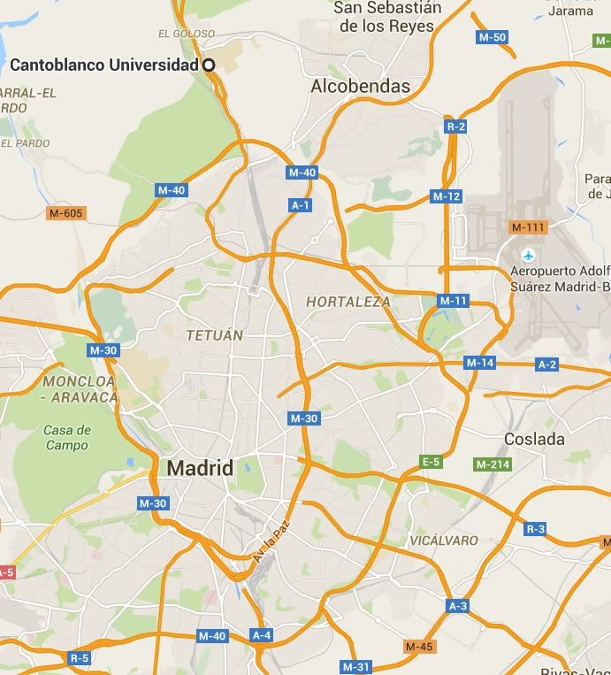
ISINIP
Airport
Hotel
areas

Slide 2
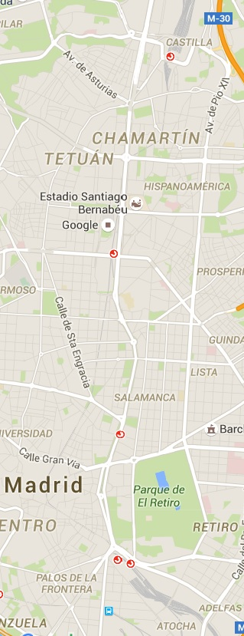
Train station
1
2
Train station
SOL
Train station
3
4
Train station

